Slide 1
Parallel LSTM Training for
Sequence Prediction from Sequential Data
CSC14116 - Applied Parallel Programming
19120454 - Bùi Quang Bảo

Slide 2
01
Introduction
About the project

Slide 3
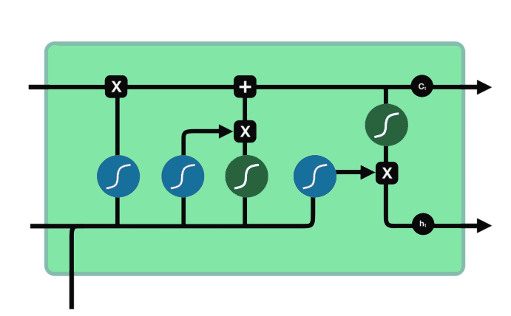
Introduction
Analyze and parallel the training process of a LSTM model.
➜ Improve training speed + handle larger datasets
Task: Sequence prediction from sequential data (Seq2Seq)
Implement a raw LSTM model using Python with Numpy library, analyze, parallelize and measure the efficiency.
Notes:
Image: https://editor.analyticsvidhya.com/uploads/47469lstm-op%20state.png

Slide 4
02
Background
About RNN and LSTM

Slide 5
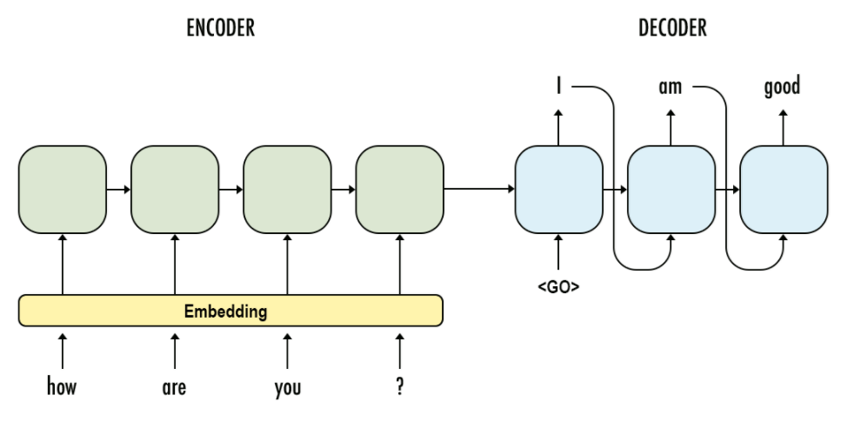
Sequence to Sequence (Seq2Seq)
Input: Sequence (List of tokens)
Output: Sequence (List of tokens)
Applications: Chatbots, Machine Translation, Text Summarization, …
Solutions for Seq2Seq: RNN, CNN, Transformers, …
Example about Seq2Seq
Notes:
Image: https://i.stack.imgur.com/mZC6M.png

Slide 6
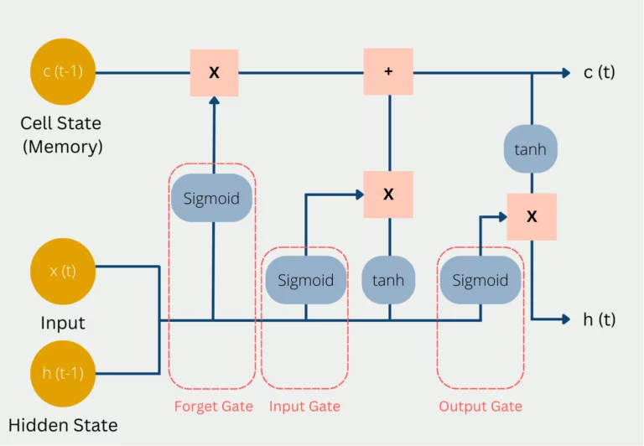
LSTM
- Long Short-Term Memory, is a type of recurrent neural network (RNN).
- LSTM networks have the ability to selectively remember or forget information over long periods of time.
- The architecture of an LSTM network includes: memory cells, input and output gates, and forget gates,...
Notes:
LSTM networks have the ability to selectively remember or forget information over long periods of time, making them particularly effective for tasks that involve sequential data, such as speech recognition, language translation, and time series prediction. The architecture of an LSTM network includes memory cells, input and output gates, and forget gates, which work together to regulate the flow of information through the network.
Image: https://databasecamp.de/en/ml/lstms

Slide 7
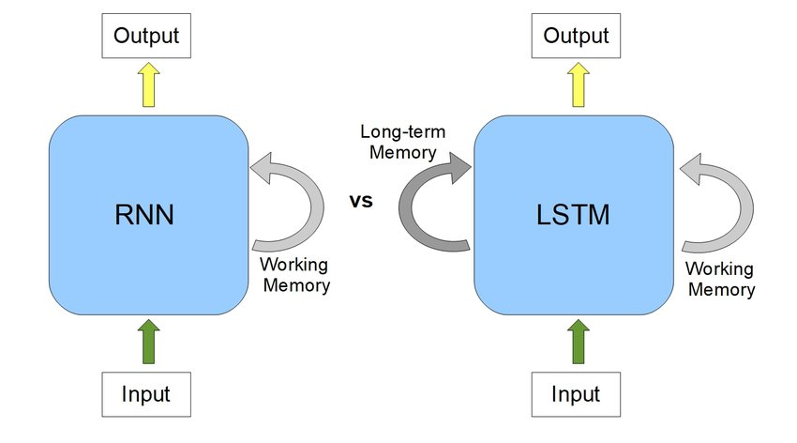
RNN and LSTM
Notes:
RNNs remember information from previous inputs but may struggle with long-term dependencies.
LSTMs effectively store and access long-term dependencies using a special type of memory cell and gates.
LSTMs solve the vanishing gradient problem in RNN.
Vanishing gradient problem: When there are more layers in the network, the value of the product of derivative decreases until at some point the partial derivative of the loss function approaches a value close to zero, and the partial derivative vanishes.
Image: https://www.researchgate.net/publication/341131167/figure/fig1/AS:887489082445828@1588605294853/RNN-v-s-LSTM-a-RNNs-use-their-internal-state-memory-to-process-sequences-of-inputs.jpg

Slide 8
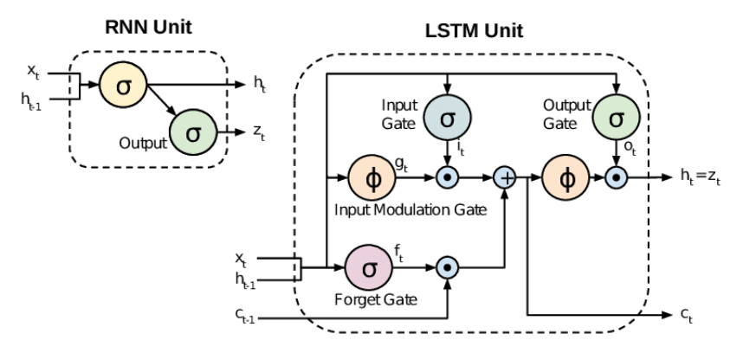
RNN and LSTM
Notes:
Image: https://ashutoshtripathicom.files.wordpress.com/2021/06/rnn-vs-lstm.png

Slide 9
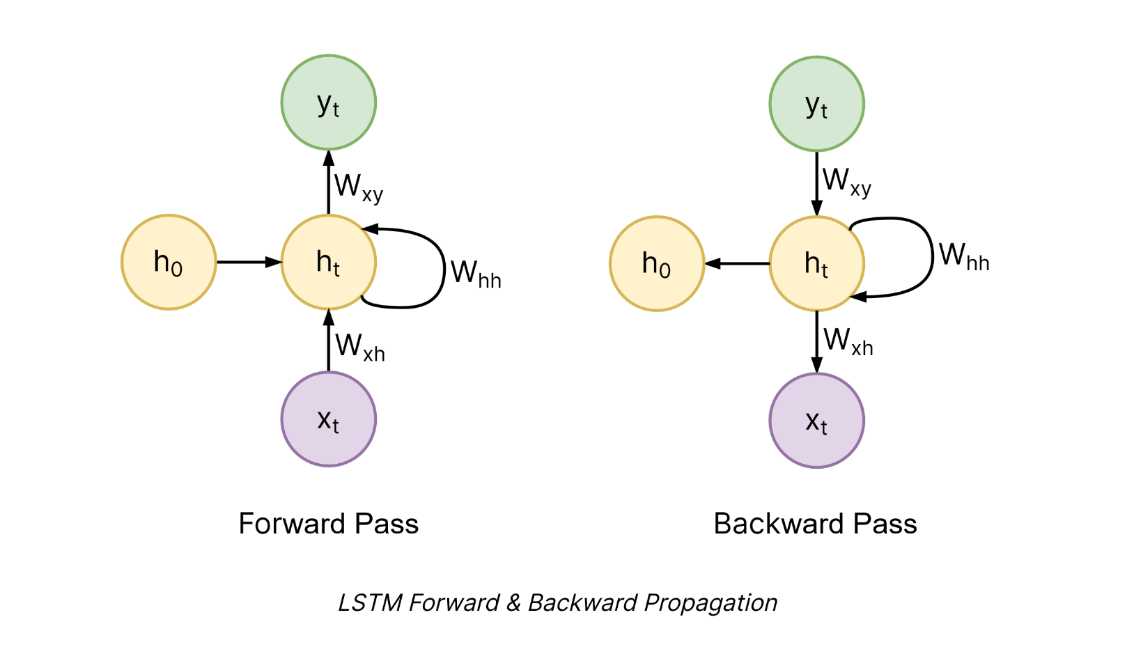
LSTM Architecture

Slide 10
Parallel Potential
- The compute-intensive process is the training phase of LSTM model.
- Some processes: data encoding, forward pass, backward pass, loss calculating, activation functions calculating, parameters optimizing,... looped for all samples for all epochs.
- The training phase of a LSTM model will benefit from parallelism.
Notes:
The compute-intensive process is the training phase of the LSTM model. For a simply explanation, the training will include some processes:
Data one-hot encoding
● Forward pass
● Backward pass
● Losses calculation
● Optimization function (for neural network parameters updating)
● …
To train the LSTM model, the initial neural network will run through a number of epochs, each epoch will “look” at all the samples of validation data and training data, each sample will go through the processes mentioned above. As a consequence, it takes a lot of time to train a good final LSTM model.
=> The training phase of a LSTM model will benefit from parallelism.
Image: https://databasecamp.de/en/ml/lstms

Slide 11
03
Challenges
Challenges for parallelizing LSTM model

Slide 12
Challenges
1. LSTM model training does not contain totally-independent loops.
- Epochs cannot be parallelized, because after each epoch, the parameters must be updated by the optimization functions (Gradient Descent or Adam).
- The process of “looking” at validation data and training data is not totally independent and it is based on how we implement the optimization functions.
2. It’s not easy to demo and visualize in comparison with other models.

Slide 13
04
Resources
Hardware resources

Slide 14


Hardware Resources
Google Colab
Kaggle

Slide 15
05
Goals
Goals and Deliverables

Slide 16
Goals
100%
125%
150%
75%
Plan to achieve
Hope to achieve 1
The final parallelized version will run x5 faster.
The final parallelized version will run x10 faster.
Hope to achieve 2
In case slowly
Training time do not scale up as quickly as the size of the dataset
The final parallelized version will run faster.

Slide 17
06
Schedule
Timeline to do the project

Slide 18
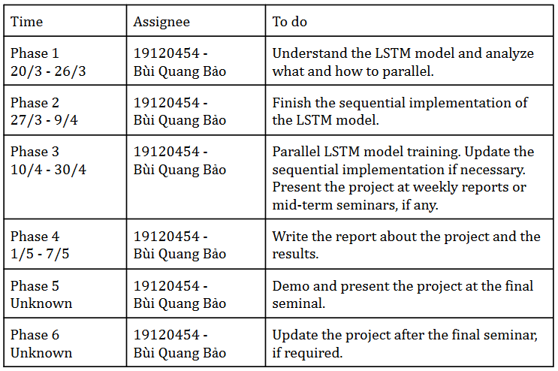
Schedule

Slide 19
07
Implementation
Implementation Strategy

Slide 20
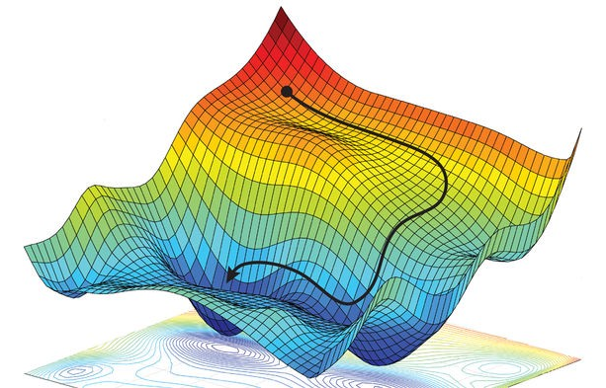
Gradient Descent
Gradient descent is an optimization algorithm which is commonly-used to train machine learning models and neural networks.
➜ Update LSTM network’s parameters

Slide 21
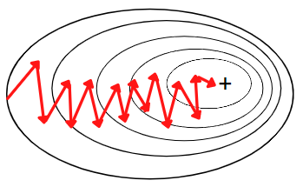
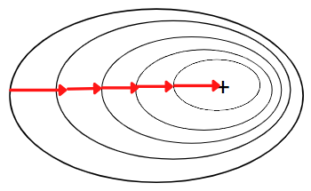
Optimization Strategy
Stochastic Gradient Descent
Batch Gradient Descent
Rough gradient
Fast
Good gradient
Slow
➜ Benefit from parallelism
Notes:
Image: https://editor.analyticsvidhya.com/uploads/58182variations_comparison.png

Slide 22
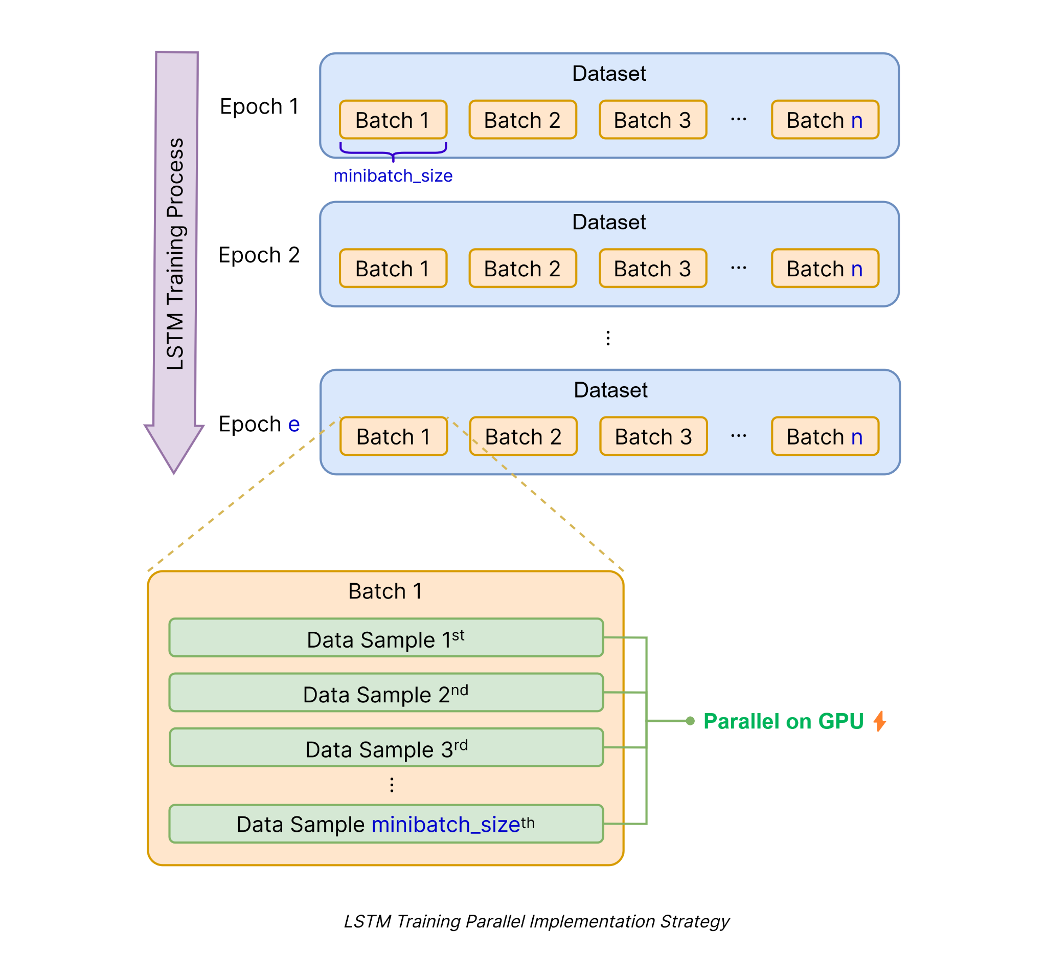
Parallel Strategy

Slide 23
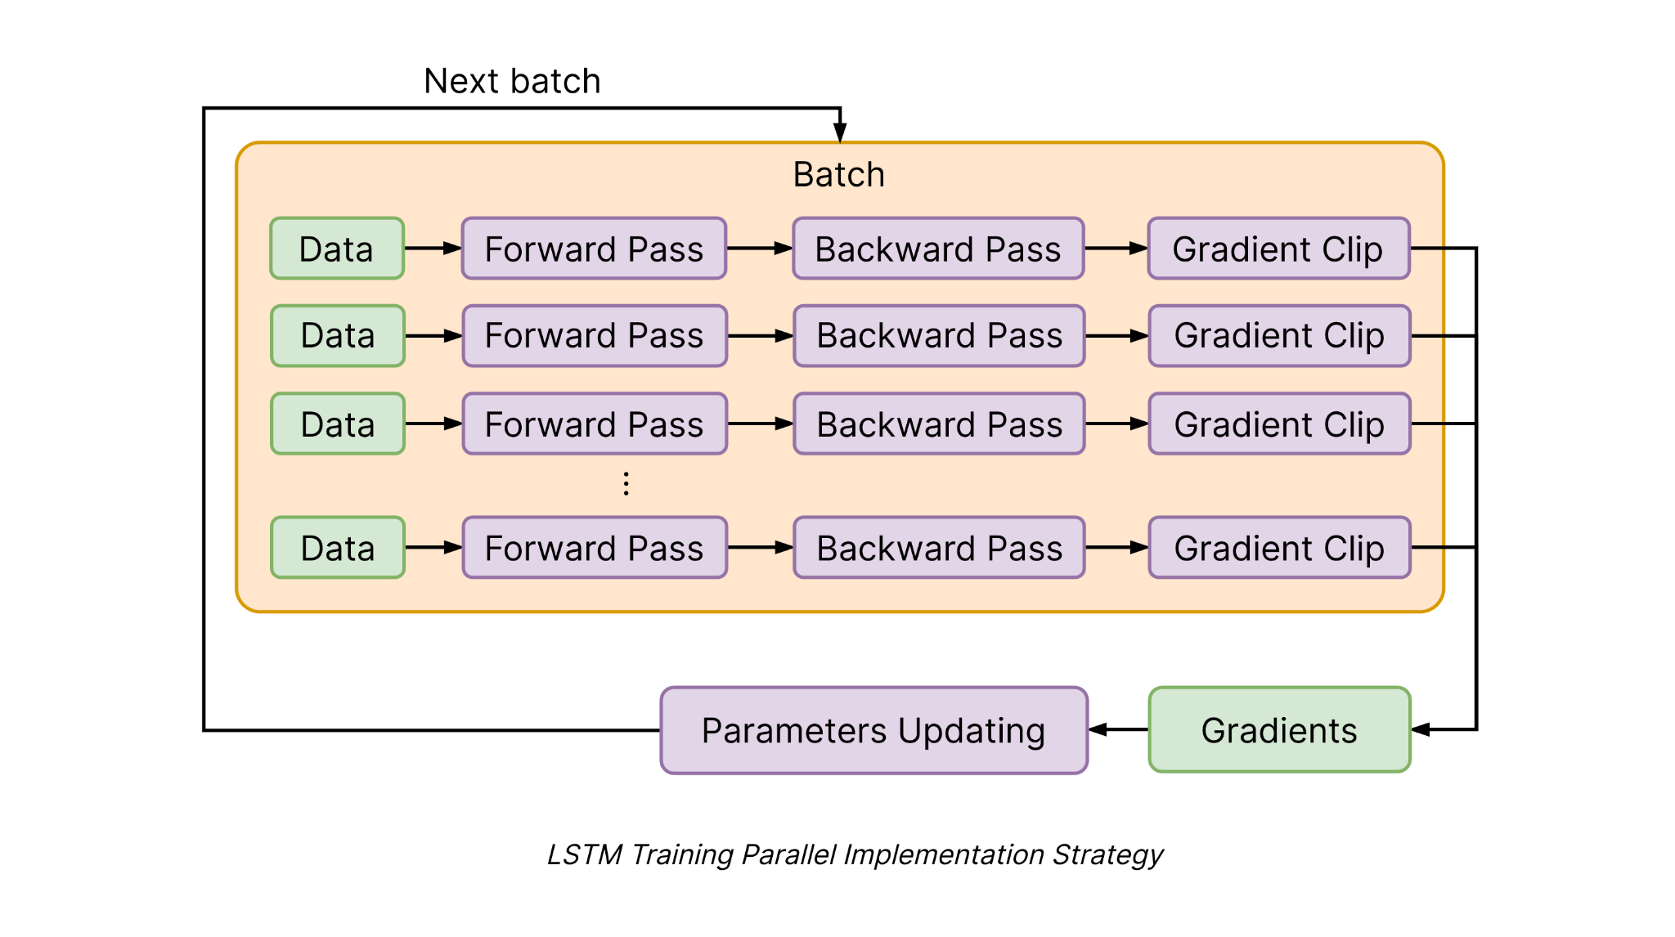
Parallel Strategy

Slide 24
08
Demo
Demo on real dataset

Slide 25
Dataset: US Airline Passengers
This dataset provides monthly totals of a US airline passengers from 1949 to 1960.
Original Source: Box, G. E. P., Jenkins, G. M. and Reinsel, G. C. (1976) Time Series Analysis, Forecasting and Control. Third Edition. Holden-Day. Series G.

Slide 26
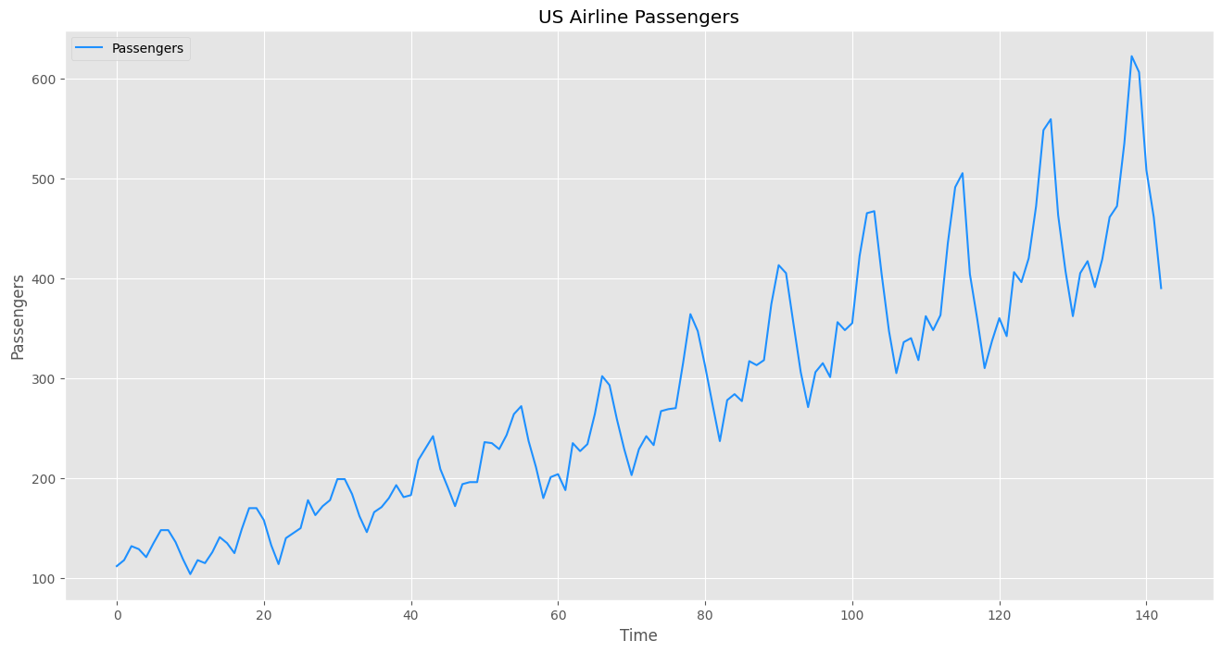
Task to solve
Predict/forecast the number of passengers of a US airline.
This is a time-series prediction task and totally fit the purpose of this project ➜ We will build a LSTM model to solve this task.

Slide 27
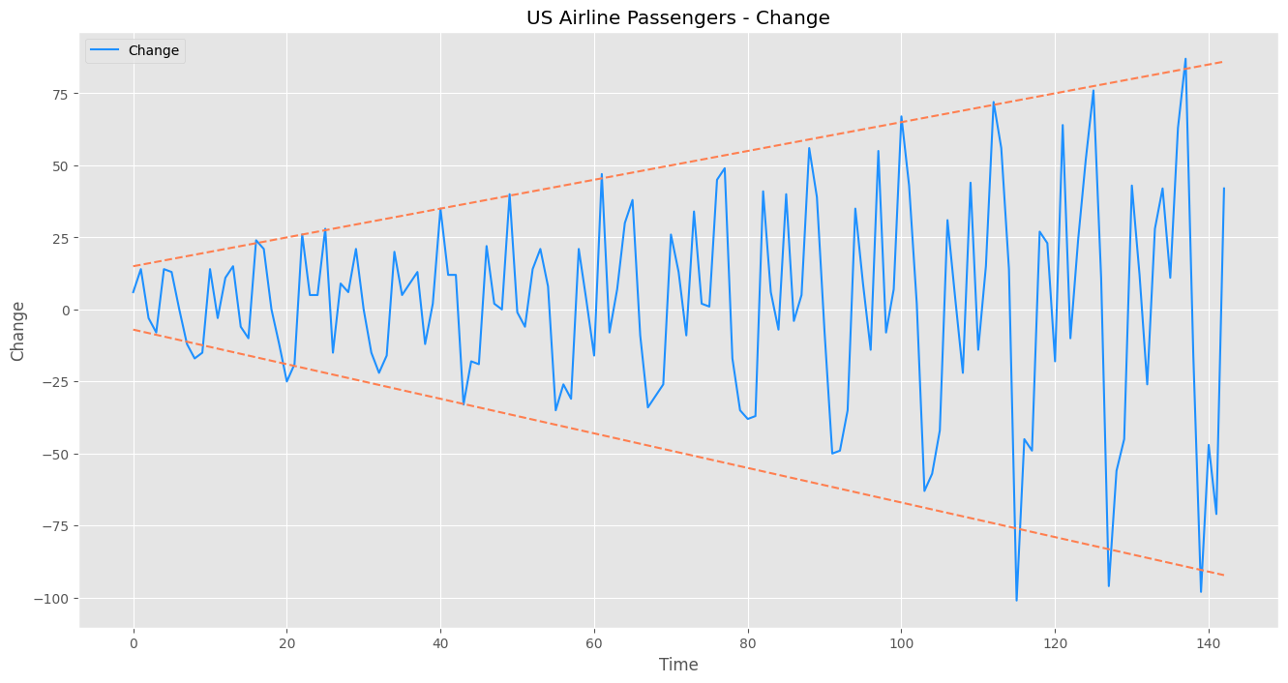
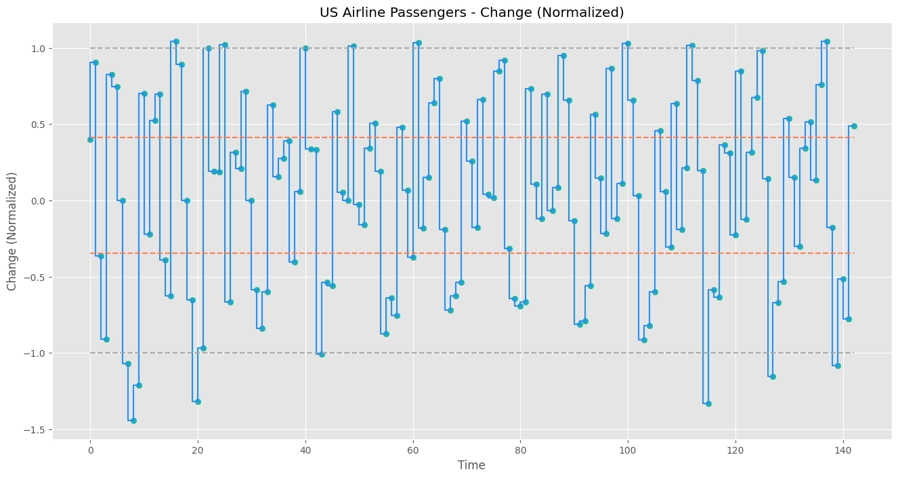
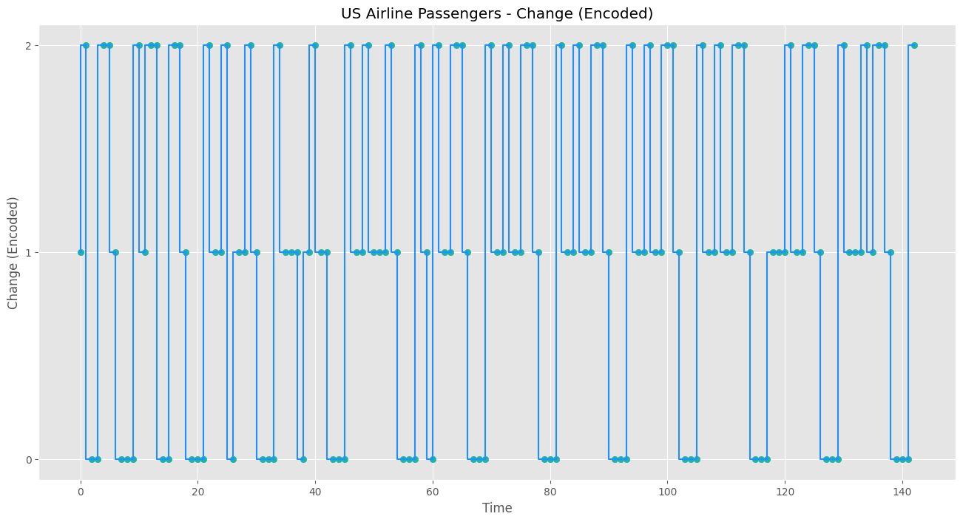
Preprocessing

Slide 28
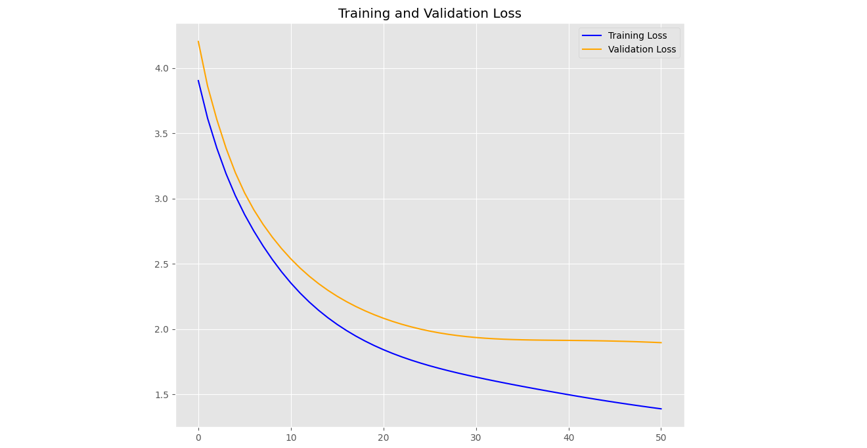
Result

Slide 29
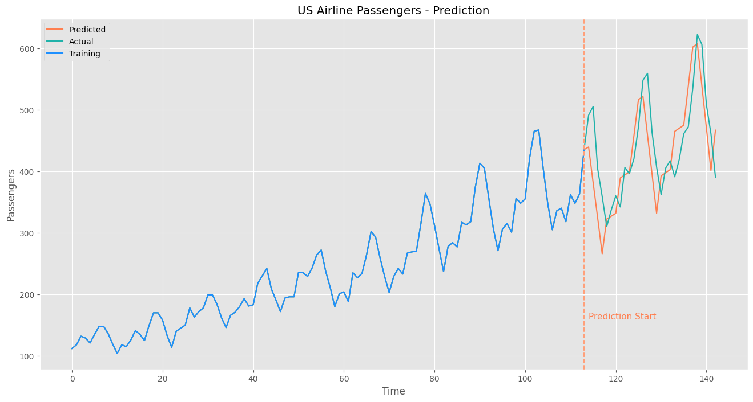
Result

Slide 30
09
Versions Comparison
Parallelization Efficiency

Slide 31
Sequential Version
This is sequential implementation of LSTM, all the processes run on CPU.
Sequential Version:
Each Epoch runs on: CPU
Each Mini-batch runs on: CPU ✖️
Each Data sample runs on: CPU ✖️
Thread positioning: No ✖️
Optimize data transferring: No ✖️

Slide 32
Numpy Version
This is sequential implementation of LSTM, use Numpy, all the processes run on CPU.
Numpy Version:
Each Epoch runs on: CPU
Each Mini-batch runs on: CPU ✖️
Each Data sample runs on: CPU ✖️
Thread positioning: No ✖️
Optimize data transferring: No ✖️

Slide 33
Parallel Version 1
This is the first parallel implementation of LSTM to run on GPU.
This version is not actually "parallel" yet, it's just a quick convert from sequential version to test the ability to run on GPU using numba.
Parallel V1:
Each Epoch runs on: CPU
Each Mini-batch runs on: GPU ✔️
Each Data sample runs on: GPU ✔️
Thread positioning: No ✖️
Optimize data transferring: No ✖️

Slide 34
Parallel Version 2
This is the second parallel implementation of LSTM to run on GPU.
In this version, for each mini-batch we will invoke kernel once, and each data sample in the mini-batch will run on a thread on GPU.
Parallel V2:
Each Epoch runs on: CPU
Each Mini-batch runs on: GPU ✔️
Each Data sample runs on: GPU ✔️
Thread positioning: Yes ✔️
Optimize data transferring: No ✖️

Slide 35
Parallel Version 3
This is the third parallel implementation of LSTM to run on GPU.
In this version, for each mini-batch we will invoke kernel once, and each data sample in the mini-batch will run on a thread on GPU. The improvement compared to the version 2 is that in this version, we avoid the unnecessary transfer for read-only data arrays.
By default, Numba automatically transfer NumPy arrays to the device, it can only do so conservatively by always transferring device memory back to the host when a kernel finishes. So, we decide to manually control the transfer behavior for these read-only data arrays:
Data: minibatch_set
Previous parameters information: U, V, W, B, b_out

Slide 36
Parallel Version 3
This is the third parallel implementation of LSTM to run on GPU.
In this version, for each mini-batch we will invoke kernel once, and each data sample in the mini-batch will run on a thread on GPU. The improvement compared to the version 2 is that in this version, we avoid the unnecessary transfer for read-only data arrays.
Parallel V3:
Each Epoch runs on: CPU
Each Mini-batch runs on: GPU ✔️
Each Data sample runs on: GPU ✔️
Thread positioning: Yes ✔️
Optimize data transferring: Yes ✔️

Slide 37
Versions
All implementation versions
 | Mini-batch | Data Sample | Thread positioning | Data transferring optimization
Sequential | CPU | CPU
Numpy | CPU | CPU
Parallel V1 | CPU+GPU | CPU+GPU | No | No
Parallel V2 | CPU+GPU | CPU+GPU | Yes | No
Parallel V3 | CPU+GPU | CPU+GPU | Yes | Yes

Slide 38
Results
5 epochs, mini-batch gradient descent
 | Wall time | Efficiency (vs. Sequential) | Efficiency (vs. Numpy) | Evaluate
Sequential | 4min 53s | 100%
Numpy | 2min 10s | 225% | 100%
Parallel V1 | 1min 20s | 366% | 162%
Parallel V2 | 18.8 s | 1558% | 691%
Parallel V3 | 17.2 s | 1703% | 756% | 🥇Best Version

Slide 39
10
Conclusion
Conclusion about the project

Slide 40
Conclusion
We successfully completed the project and reached the goal we stated in the project's proposal (100%)
 | Wall time | Efficiency (vs. Sequential) | Efficiency (vs. Numpy)
Sequential | 4min 53s | 100%
Numpy | 2min 10s |  | 100%
Parallel V3 | 17.2 s | 1703% | 756%

Slide 41
Thanks for listening!

